Slide 1
Partner
PRESTO Symposium May 2023
A One Health Approach in Captive Wildlife

Slide 2
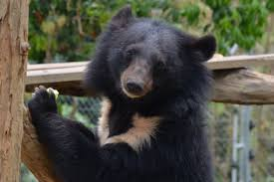
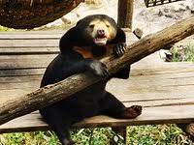
Free the Bears
FREE THE BEARS is a wildlife conservation and animal welfare organisation that works with local communities and governments in Cambodia, Vietnam and Laos to help protect and save bears from the illegal wildlife trade.
Laos sanctuary rescues other species from the wildlife trade, with the hopes of rehabilitation and release back into the wild.
2003: establishes the first bear rescue center in Laos
2017: establishes a multi-species wildlife rescue center
2019: Wildlife hospital is completed
Since then, Free the bears has been working towards increasing the capabilities of the wildlife hospital, including improving diagnostic capabilities and establishing disease surveillance protocols, with particular focus on zoonotic diseases.

Slide 3
What research do we conduct?
In the past we have had limited opportunities to support projects here in Laos mainly due to lack of available staff, infrastructure, budget and resources. Also restrictions due to COVID-19.
Improving diagnostic capabilities and preventative monitoring protocols for zoonotic diseases: currently focused on tuberculosis (TB).
This will hopefully lead onto further studies focusing on assessing the validity of PCR testing for detection of Mycobacterium tuberculosis DNA using non-invasive faecal sampling.

Slide 4
How do we conduct research?
Human resources:
Currently on staff in Laos:
- Senior Veterinarian (international)
- Resident Veterinarian (local)
- Veterinary Nurse (international)
- Animal Technical Advisor/ Animal Manager (international)
- Animal keepers (local)
International researchers collecting data in Laos for research projects
Environment-facilities:
Wildlife hospital with laboratory:
Digital X-ray
Ultrasound
Microscope
Vetscan VS2- Biochemistry analyser
Basic fecal and urine testing equipment

Slide 5
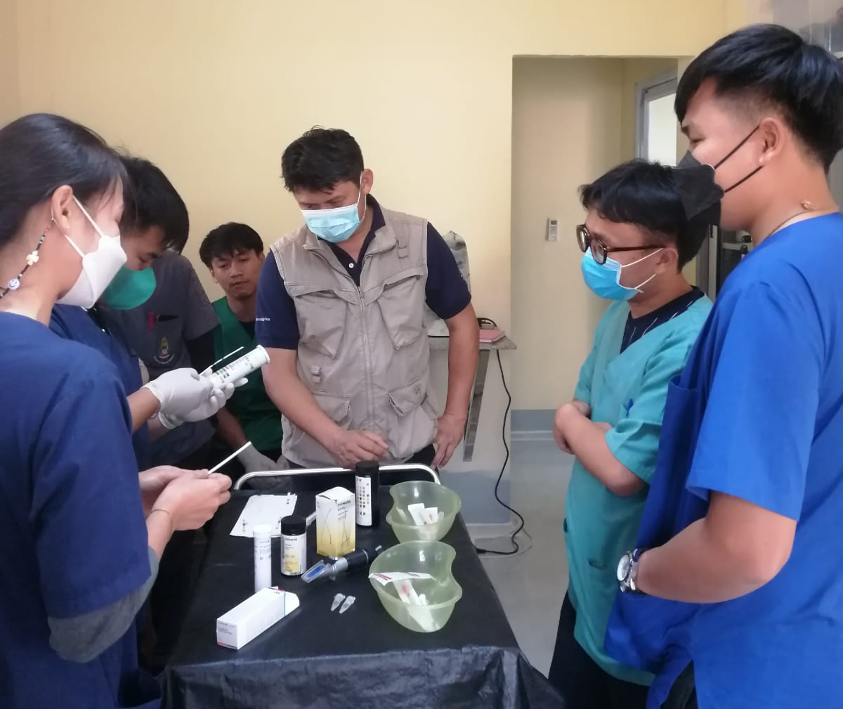
How would we like to improve our research/activities?
Develop species-specific disease surveillance protocols for rescued wildlife coming to the sanctuary and for wildlife suitable for re-release
Upgrade diagnostic facilities in the veterinary hospital to improve diagnostic capabilities. Extend to supporting the implementation of animal/wildlife specific diagnostic facilities
Incorporate education and training strategies into the project to support future researchers in Laos
Develop long term monitoring and research programs using local staff and researchers
Notes:
Better understand disease risks currently faced by wildlife coming to our sanctuary and develop species specific testing protocols to help stop the spread of pathogens in our sanctuary as well as helping develop release protocols to stop the spread of pathogens back into the wild
Improving our in house diagnostic facilities allows for faster and possibly cheaper testing on for a variety of pathogens. Also allows for further research projects and other studies to be conducted on site. This lessens our need to rely on outsourcing, especially to international laboratories. When in-house testing is not a viable option, we should be supporting the implementation and use of domestic testing facilities. E.g. our current tuberculosis testing issues
We must focus on passing our knowledge onto the next generation of Lao researchers to help stop reliance on international projects and resources. E.g. training of our resident vet and starting internships with vet students from NUoL
It can be difficult to collect long-term data and see changing trends when we have international researchers, as they are only able to collect data on a limited period of time when they travel here e.g. the effects of seasonality

Slide 6
What are the knowledge gaps we would like to address?
Practical gaps:
Develop improved biosecurity protocols to help prevent transmission of pathogens between domestic animals and humans to captive wildlife at our sanctuary
Capacity gaps:
Lack of expertise, especially related to specific laboratory techniques and testing methods
Lack of trained staff available to focus on one-health specific research questions
Improvements in these areas will lead to a more efficient One-Health approach for captive wildlife
Notes:
Our sanctuary is surrounded by farms and domestic livestock. This is a challenge when trying to maintain strict quarantine and biosecurity
Small veterinary team who can perform basic diagnostic tests but have not had the opportunity to learn advanced laboratory techniques

Slide 7
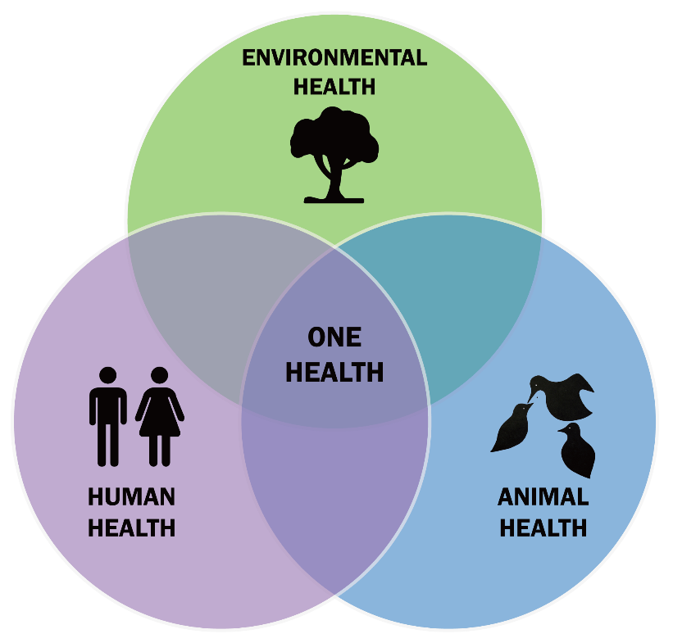
What is the most important/pressing question to address in a ONE-HEALTH research proposal ?
How do we effectively manage zoonotic/reverse zoonotic disease risk in captive wildlife populations in sanctuaries in rural Southeast Asia?

Slide 8
Thank You
If you would like to know more about Free the Bears please visit:
https://freethebears.org/
If you have any further questions, please email me at:
jacqui@freethebears.org

